Slide 1
Waves Introduction – Jan 13
Agenda (60 min):
Schedule to End of Term
Discussion: Unit 6 Concepts
Practice Questions
Locker Cleanup (@9:50)
Upcoming
n/a

Slide 2
January Schedule
Today & Next Week
Waves & Sound
Friday, Jan 20
Waves Summative
Mon & Tues (Jan 23 & 24)
Reflection Summative (10 %)
Final Exam
Monday, Jan 30 @ 12:30 (20 %)

Slide 3

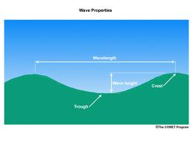
What are Waves?
We usually think of water waves.
What are some properties of waves?
Question: How can a tsunami travel at 300 km/hr?

Slide 4
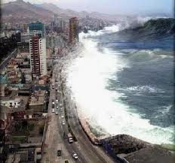
Key Points About Waves
Key Points:
Waves transport energy
Waves do not displace the medium (e.g. water)
Tsunami question answer:
In deep water the wave is hardly detectable
The wave moves water up and down only a tiny amount.
Water does not move in the direction of the wave (e.g. 300 km/hr)
On a sloping beach the wave motion gets confused with other effects.

Slide 5
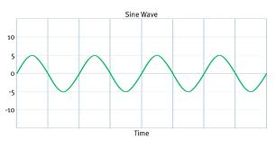
Properties of a Wave
Waves are a repeating oscillation (e.g. sine wave)
Amplitude
Crest
Equilibrium Position
Trough

Slide 6
Properties of a Wave
Waves are defined by their Wavelength (λ)
λ
λ

Slide 7

Properties of a Wave
Draw a diagram of this water ripple pattern
Label a crest and a trough
Label a wavelength
Crest
λ
Trough

Slide 8
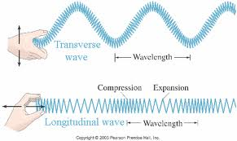
Types of Waves
How many different ways can we make a wave in a slinky?
Video 1

Slide 9
Types of Waves
Transverse Waves
A wave that moves perpendicular to the medium
Longitudinal Waves
A wave that moves parallel to the medium
Also called compression waves

Slide 10
Kinds of Waves
 | Medium | Type of Wave (transverse or Longitudinal)
Water Wave | Water
Sound Wave | Air
Earthquake | Rock
Light | Electromagnetic Field

Slide 11
Kinds of Waves
 | Medium | Type of Wave (transverse or Longitudinal)
Water Wave | Water | Transverse
Sound Wave | Air | Longitudinal
Earthquake | Rock | Both
Light | Electromagnetic Field | Transverse

Slide 12
Practice
Read about waves in 2 and 3 dimensions
Read about Rays
Read about Energy Pulses
Answer Questions, Page 302:
#2, #3, #4
#5, #7, #8, #10, #11, #12

